Slide 1
GEO 330 EXERCISE 2
Adrian Frontera
Febuary 1st, 2023

Slide 2
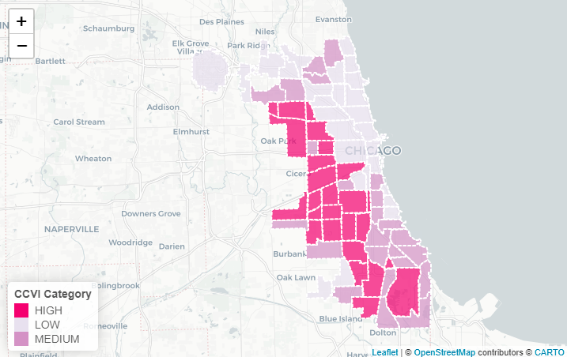
CCVI Distribution by Community Area Chicago, Illinois, 2022

Slide 3
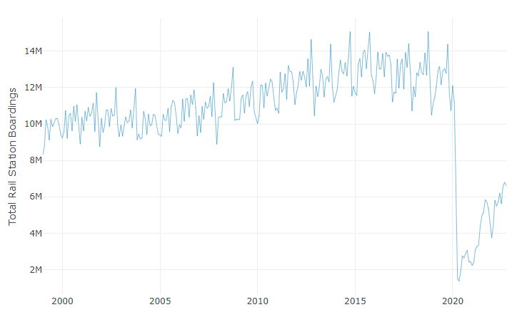
CTA Rail Station Boardings by Month Between January 1999 through October 2022 in Chicago, Illinois

Slide 4
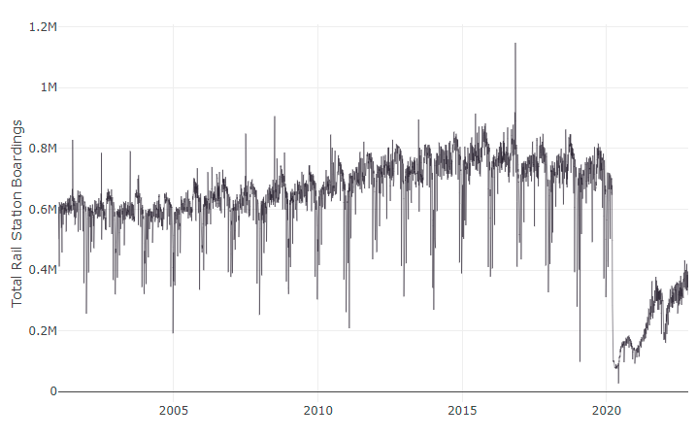
CTA Rail Station Boardings by Day Between January 1999 through October 2022

Slide 5
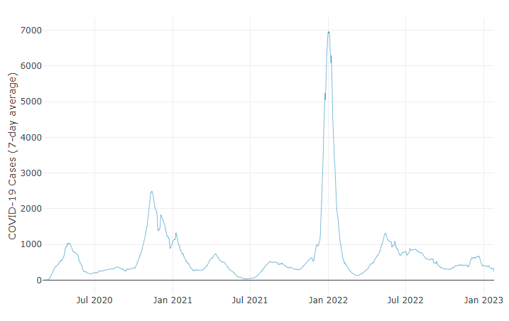
COVID-19 Cases (rolling 7-day average) by Week, Chicago, Illinois

Slide 6
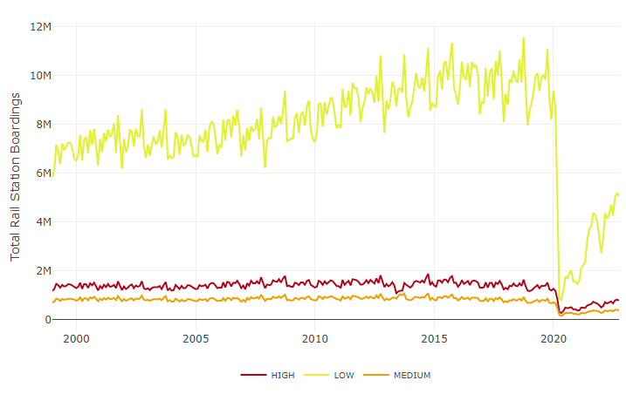
Rail Boardings by CTA Rail Station CCVI Category, Chicago, Illinois, 1999-2022

Slide 7
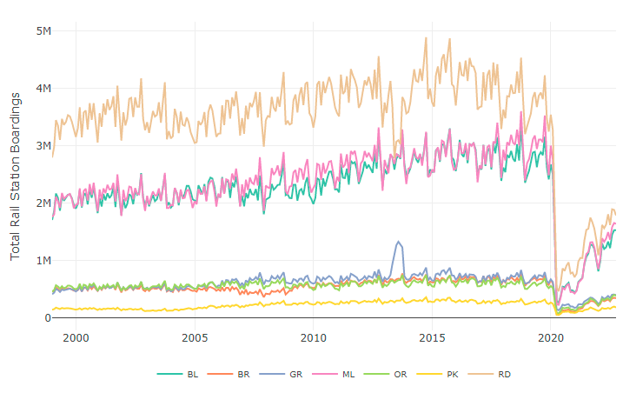
CTA L Station Rail Boardings by Line, Chicago, Illinois, 1999-2022

